Slide 1
Lecture 15: Query Optimization

Slide 2
Announcements
2
Today, right after lecture, exam review in this room for ~30 minutes. Additional questions in office hours.
Scheduling: I'm away next week
Old Plan: Zhongrui + 1 canceled class.
New Plan:
In class office hours with the TA's both days
To work on B+Tree
B+Tree NEW DEADLINE Friday 11/7.

Slide 3
Last Class
We talked about how to design the DBMS's architecture to execute queries in parallel.
The query plan is comprised of physical operators that specify the algorithm to invoke at each step of the plan.
But how do we go from SQL to a query plan?

Slide 4
Motivation
Total: 2M I/Os
π_{ename}
SELECT DISTINCT ename FROM Emp E JOIN Dept D ON E.did = D.did
WHERE D.dname = 'Toy'
4 reads + 1 write
σ_{dname = 'Toy'}
Catalog
2,000 reads + 4 writes (10K/500 = 20 emps per dept)
clustered
unclustered
unclustered
Emp(ssn,ename,addr,sal,did)
σ_{Emp.did = Dept.did}
10,000 records
1,000 pages
1,000,000 reads + 2,000 writes (FK join, 10k tuples in temp T2)
clustered
unclustered
×
Dept(did,dname,floor,mgr)
(50 + 50,000) reads + 1,000,000 writes
Write temp file T1 5 tuples per page in T1
500 records
50 pages
Emp
Dept

Slide 5
Motivation
SELECT DISTINCT ename FROM Emp E JOIN Dept D ON E.did = D.did
WHERE D.dname = 'Toy'
Total: 54k I/Os
π_{ename}
Catalog
4 reads + 4 writes Read temp T2
clustered
unclustered
unclustered
Emp(ssn,ename,addr,sal,did)
σ_{dname = 'Toy'}
10,000 records
1,000 pages
2,000 reads + 4 writes Read temp T1, Write temp T2
clustered
unclustered
⋈_{Emp.did = Dept.did}
Dept(did,dname,floor,mgr)
(50 + 50,000) reads + 2,000 writes
Page Nested-Loop Join Write Temp T1
500 records
50 pages
Emp
Dept

Slide 6

Motivation
SELECT DISTINCT ename FROM Emp E JOIN Dept D ON E.did = D.did
WHERE D.dname = 'Toy'
Vectorization Model
Total: 3,151 I/Os
No Pipelining!
Materialization Model
Total: 7,159 I/Os
π_{ename}
Catalog
4 reads + 4 writes Read temp T2
clustered
unclustered
unclustered
Emp(ssn,ename,addr,sal,did)
σ_{dname = 'Toy'}
10,000 records
1,000 pages
2,000 reads + 4 writes Read temp T1, Write temp T2
clustered
unclustered
⋈_{Emp.did = Dept.did}
Dept(did,dname,floor,mgr)
3×(|Emp| + |Dept| = 3,150 reads + 2,000 writes
Sort-Merge Join (50 Buffers) Write Temp T1
500 records
50 pages
Emp
Dept

Slide 7
Motivation
SELECT DISTINCT ename FROM Emp E JOIN Dept D ON E.did = D.did
WHERE D.dname = 'Toy'
Total: 37 I/Os
π_{ename}
Catalog
4 reads + 1 writes Read temp T2
clustered
unclustered
unclustered
Emp(ssn,ename,addr,sal,did)
σ_{dname = 'Toy'}
10,000 records
1,000 pages
1 + 3 (idx) + 20 (ptr chase) reads + 4 writes Index Nested-Loop Join
clustered
unclustered
⋈_{Emp.did = Dept.did}
⋈_{Emp.did = Dept.did}
Dept(did,dname,floor,mgr)
500 records
50 pages
3 reads + 1 writes
Access: Index(dname)
Emp
Dept
Emp

Slide 8
Today's Agenda
8
Background
Heuristic / Ruled-based Optimization
Cost-based Optimization
Cost Model Estimation
Warning #1: This is hard.
Warning #2: There could be a whole course in this, we have one lecture.

Slide 9




Architecture Overview
Cost
Model
Application
System
Catalog
Schema Info
1
SQL Query
Estimates
Optimizer
Parser
4
Physical Plan
Name→Internal ID
Binder
2
Abstract
Syntax
Tree
3
Logical Plan
Notes:
Logical Plan: There can be many valid alternatives of logical plans for a single SQL query.
Some systems skips the optimizer step.
Optimizer is usually the most espensive

Slide 10
Logical vs Physical Plans
The optimizer generates a mapping of a logical algebra expression to the optimal equivalent physical algebra expression.
Physical operators define a specific execution strategy using an access path.
They can depend on the physical format of the data that they process (i.e., sorting, compression).
Not always a 1:1 mapping from logical to physical.
Notes:
Logical Join + Logical OrderBy -> Physical SortMergeJoin

Slide 11
Query Optimization (QO)
Identify candidate equivalent trees (logical). It is an NP-hard problem, so the space is large.
For each candidate, find the execution plan (physical). Estimate the cost of each plan.
Choose the best (physical) plan.
Practically: Choose from a subset of all possible plans.
Subspace that a practical QO searches
p_{n}
p₁
p_{i}
p₂
p₃
Entire search space very large, as QO is NP-hard (w.r.t. # joins)
Notes:
Given RA tree
Best way of evaluating it
- Produce annotated RA trees
- Annotation indicates operator evaluation algorithm
Identify candidate equivalent trees
For each candidate find best annotated version
Choose the best overall

Slide 12
Query Optimization
Heuristics / Rules
Rewrite the query to remove (guessed) inefficiencies.
Examples: always do selections first or push down projections as early as possible.
These techniques may need to examine catalog, but they do not need to examine data.
Cost-based Search
Use a model to estimate the cost of executing a plan.
Enumerate multiple equivalent plans for a query and pick the one with the lowest cost.
Notes:
Today talk about cost model. Next lecture about enumeration
Unlikely to find an optimal plan

Slide 13
Logical Plan Optimization
Transform a logical plan into an equivalent logical plan using pattern matching rules.
The goal is to increase the likelihood of enumerating the optimal plan in the search.
Many equivalence rules for relational algebra!
Cannot compare plans because there is no cost model but can "direct" a transformation to a preferred side.
Notes:
The enumeration step will come next week.
Cannot guarantee that we will always find the optimal plan.

Slide 14
Predicate Pushdown
π_{ename}
π_{ename}
σ_{dname = 'Toy'}
⋈_{Emp.did = Dept.did}
⋈_{Emp.did = Dept.did}
σ_{dname = 'Toy'}
Emp
Dept
Emp
Dept
π_{ename} (σ_{dname = 'Toy'} (Dept ⋈ Emp))
Rewrite
π_{ename} (Emp ⋈ σ_{dname = 'Toy'} (Dept))

Slide 15
Replace Cartesian Product
σ_{Emp.did = Dept.did}
×
⋈_{Emp.did = Dept.did}
Emp
Dept
Emp
Dept
… (σ_{Dept.did = Emp.did} (Dept × Emp))
Rewrite
… (Emp ⋈_{Emp.did = Dept.did} Dept)

Slide 16
Projection Pushdown
π_{ename}
π_{ename}
⋈_{Emp.did = Dept.did}
⋈_{Emp.did = Dept.did}
π_{ename,did}
…
…
Emp
Emp
π_{Emp.ename} (… ⋈_{did} Emp)
Rewrite
π_{Emp.ename} (… ⋈_{did} (π_{ename, did} Emp))

Slide 17
Equivalence
σ_{P1} (σ_{P2}(R)) ≡ σ_{P2} (σ_{P1}(R)) (σ commutativity)
σ_{P1⋀P2 … ⋀Pn} (R) ≡ σ_{P1}(σ_{P2}( … σ_{Pn}(R))) (cascading σ)
∏_{a1}(R) ≡ ∏_{a1}(∏_{a2}(…∏_{ak} (R)…)), a_{i} ⊆ a_{i+1} (cascading ∏)
R ⋈ S ≡ S ⋈ R (join commutativity)
R ⋈ (S ⋈ T) ≡ (R ⋈ S) ⋈ T (join associativity)
σ_{P} (R X S) ≡ (R ⋈_{P} S), if P is a join predicate
σ_{P} (R X S) ≡ σ_{P1} (σ_{P2}(R) ⋈_{P4} σ_{P3}(S)) , where P = p1 ∧ p2 ∧ p3 ∧ p4
∏_{A1,A2,…An}(σ_{P} (R)) ≡ ∏_{A1,A2,…An}(σ_{P} (∏_{A1,…An, B1,… BM}R)), where B1 … BM are columns in P
…

Slide 18
Query Optimization
Heuristics / Rules
Rewrite the query to remove (guessed) inefficiencies.
Examples: always do selections first or push down projections as early as possible.
These techniques may need to examine catalog, but they do not need to examine data.
Cost-based Search
Use a model to estimate the cost of executing a plan.
Enumerate multiple equivalent plans for a query and pick the one with the lowest cost.
Notes:
Today talk about cost model. Next lecture about enumeration
Unlikely to find an optimal plan

Slide 19
Cost-Based Query Optimization
We will start with cost-based, bottom-up QO
Aka the "classic" IBM System R optimizer
Approach: Enumerate different plans for the query and estimate their costs.
Single relation.
Multiple relations.
Nested sub-queries.
It chooses the best plan it has seen for the query after exhausting all plans or some timeout.
Notes:
Can't do exhaustive search since it's NP hard.

Slide 20
Single-Relation Query Planning
Pick the best access method.
Sequential Scan
Binary Search (clustered indexes)
Index Scan
Predicate evaluation ordering.
Simple heuristics are often good enough for this.

Slide 21
Multi-Relation Query Planning
Approach #1: Generative / Bottom-Up
Start with nothing and then iteratively assemble and add building blocks to generate a query plan.
Examples: System R, Starburst
Approach #2: Transformation / Top-Down
Start with the outcome that the query wants, and then transform it to equivalent alternative sub-plans to find the optimal plan that gets to that goal.
Examples: Volcano, Cascades
Notes:
How to generate different join orderings to feed into the optimizer's search model.
Need to be efficient to not slowdown the search.
#1 – Incrementally build the query plan starting from nothing.
#2 – Premute an existing plan.
Top-down allows you to employ branch-and-bound pruning to perform early termination of exploring a branch in the tree.

Slide 22
Bottom-Up Optimization
Use static rules to perform initial optimization. Then use dynamic programming to determine the best join order for tables using a divide-and-conquer search method
Examples: IBM System R, DB2, MySQL, Postgres, most open-source DBMSs.
Notes:
Bottom-up: Start with nothing, then build the query plan from the bottom up to reach our final goal, which is the correct query result. This is what MySQL, Postgres, and SQLite use.

Slide 23

System R Optimizer
Left-Deep Tree
Break query into blocks and generate logical operators for each block.
For each logical operator, generate a set of physical operators that implement it.
All combinations of join algorithms and access paths
Then, iteratively construct a “left-deep” join tree that minimizes the estimated amount of work to execute the plan.
D
C
A
B
outer
inner
Bushy Tree
A
B
C
D

Slide 24
System R Optimizer
SELECT ARTIST.NAME
FROM ARTIST, APPEARS, ALBUM
WHERE ARTIST.ID=APPEARS.ARTIST_ID
AND APPEARS.ALBUM_ID=ALBUM.ID
AND ALBUM.NAME=“Andy's OG Remix”
ORDER BY ARTIST.ID
ARTIST: | Sequential Scan
APPEARS: | Sequential Scan
ALBUM: | Index Look-up on NAME
Step #1: Choose the best access paths to each table
ARTIST ⨝ APPEARS ⨝ ALBUM
APPEARS ⨝ ALBUM ⨝ ARTIST
ALBUM ⨝ APPEARS ⨝ ARTIST
APPEARS ⨝ ARTIST ⨝ ALBUM
ARTIST × ALBUM ⨝ APPEARS
ALBUM × ARTIST ⨝ APPEARS
⋮ ⋮ ⋮
Step #2: Enumerate all possible join orderings for tables
Step #3: Determine the join ordering with the lowest cost
Notes:
Retrieve the names of people that appear on Andy’s mixtape ordered by their artist id.
A dynamic programming approach that estimates the cost of doing the joins in stages. Get to the end point of the search where we've joined all the tables we want together. Then backtrack to figure out what was the fastest way for me to get there.

Slide 25
System R Optimizer
Logical Op
Physical Op
ARTIST ⨝ APPEARS ⨝ ALBUM
The query has ORDER BY on ARTIST.ID but the logical plans do not contain sorting properties.
HASH_JOIN(A1⨝A3,A2)
MERGE_JOIN(A1⨝A3,A2)
HASH_JOIN(A2⨝A3,A1)
MERGE_JOIN(A2⨝A3,A1)
HASH_JOIN(A3⨝A2,A1)
MERGE_JOIN(A3⨝A2,A1)
• • •
APPEARS.ALBUM_ID=ALBUM.ID
APPEARS.ARTIST_ID=ARTIST.ID
APPEARS.ARTIST_ID=ARTIST.ID
ARTIST⨝APPEARS ALBUM
ALBUM⨝APPEARS ARTIST
APPEARS⨝ALBUM ARTIST
• • •
Hack: Keep track of best plans with and without data in proper physical form, and then check whether tacking on a sort operator at the end is better.
HASH_JOIN(A1,A3)
MERGE_JOIN(A1,A3)
HASH_JOIN(A2,A3)
MERGE_JOIN(A2,A3)
HASH_JOIN(A3,A2)
MERGE_JOIN(A3,A2)
• • •
ALBUM.ID=APPEARS.ALBUM_ID
ARTIST.ID=APPEARS.ARTIST_ID
APPEARS.ALBUM_ID=ALBUM.ID
ARTIST ALBUM APPEARS
Notes:
SystemR uses a bottom-up approach where don't have any joins ordering or algos.
The top is the end result. So build the plan going up to figure out how to get to the end.
Generate all possible orderings at the first stage for joining two tables.
For each physical op, I estimate the cost. For each path to a logical op, pick the one with the lowest cost.
Bake into the cost model the required physical properties of the data so that the search algorithm will choose the proper plan.

Slide 26
SYSTEM R OPTIMIZER
Π_{year, artist_name, album_name}
ARTIST ⨝ APPEARS ⨝ ALBUM
Hash Join … Estimates: output cardinality = …
⋈_{artist_id}
HASH_JOIN(A2⨝A3,A1)
Hash Join … output cardinality = …
⋈_{album_id}
File Scan
output cardinality = 10K
ALBUM⨝APPEARS ARTIST
Artists
ALBUM.ID=APPEARS.ALBUM_ID
σ_{genre = ‘Blues’}
Appears
File Scan
output cardinality = 10K
HASH_JOIN(A2,A3)
Unclustered B-tree
output cardinality = …
ARTIST ALBUM APPEARS
Album

Slide 27
Top-Down Optimization
Start with a logical plan of what we want the query to be. Perform a branch-and-bound search to traverse the plan tree by converting logical operators into physical operators.
Keep track of global best plan during search.
Treat physical properties of data as first-class entities during planning.
Examples: MSSQL, Greenplum, CockroachDB
Notes:
Graefe worked on three query optimizers in the 1990s. The first was Exodus. Volcano second. Cascades is the third.
Record the physical properties of data directly in the operators so that we don't need separate logic to figure out whether the data is sorted, etc.
Never implemented outside of academia. Paper talks about other systems at the time using Volcano but they were all at other universities.
The optimizer needs to enumerate all possible transformations without repeating.
Go from logical to physical plan as fast as possible, then try alternative plans.
Use a top-down rules engine that performs branch-and-bound pruning.
Use memoization to cache equivalent operators.
Optimizer generator: Instead of writing the optimizer using procedural code, have a set of rules that “generate” the optimized plan.

Slide 28
Top-Down Optimization
Logical Op
Physical Op
Start with a logical plan of what we want the query to be.
ARTIST ⨝ APPEARS ⨝ ALBUM
ORDER-BY(ARTIST.ID)
Invoke rules to create new nodes and traverse tree.
Logical→Logical: JOIN(A,B) to JOIN(B,A)
Logical→Physical: JOIN(A,B) to HASH_JOIN(A,B)
QUICKSORT(A1.ID)
HASH_JOIN(A1⨝A2,A3)
MERGE_JOIN(A1⨝A2,A3)
HASH_JOIN(A1⨝A2,A3)
ARTIST⨝APPEARS
ALBUM⨝APPEARS
ARTIST⨝ALBUM
Can create "enforcer" rules that require input to have certain properties.
HASH_JOIN(A1,A2)
MERGE_JOIN(A1,A2)
ARTIST
ALBUM
APPEARS
Notes:
The EXODUS and Volcano “optimizer generators” has separte sets for the (logical) transformation and (physical) rules.
Cascades has just one set. “A rule has an an antecedent (the ”before” pattern), and a consequent (the substitute). Pattern and substitute are represented as expression trees.”

Slide 29
Observation
Applications often execute nested queries.
We could optimize each block using the methods we have discussed.
However, this may be inefficient since we optimize each block separately without a global approach.
What if we could flatten a nested query into a single block and optimize it?
Then, apply single-block query optimization methods.
Even if one cannot flatten to a single block, flattening to fewer blocks is still beneficial.

Slide 30
Nested Sub-Queries
The DBMS treats nested sub-queries in the where clause as functions that take parameters and return a single value or set of values.
Approach #1: Rewrite to de-correlate and/or flatten them.
Approach #2: Decompose nested query and store results in a temporary table.

Slide 31
Nested Sub-queries: Rewrite
SELECT name FROM sailors AS S
WHERE EXISTS (
SELECT * FROM reserves AS R
WHERE S.sid = R.sid
AND R.day = '2022-10-25'
)
SELECT name
FROM sailors AS S, reserves AS R
WHERE S.sid = R.sid
AND R.day = '2022-10-25'

Slide 32
Decomposing Queries
For harder queries, the optimizer breaks up queries into blocks and then concentrates on one block at a time.
Sub-queries are written to temporary tables that are discarded after the query finishes.

Slide 33
Decomposing Queries
Inner Block
SELECT MAX(rating) FROM sailors
SELECT S.sid, MIN(R.day)
FROM sailors S, reserves R, boats B
WHERE S.sid = R.sid
AND R.bid = B.bid
AND B.color = 'red'
AND S.rating = (SELECT MAX(S2.rating)
FROM sailors S2)
GROUP BY S.sid
HAVING COUNT(*) > 1
###
Outer Block
Nested Block
Notes:
For each sailor with the highest rating (over all sailors) and at least two reservations for red boats, find the sailor id and the earliest date on which the sailor has a reservation for a red boat.

Slide 34
Expression Rewriting
An optimizer transforms a query’s expressions (e.g., WHERE/ON clause predicates) into the minimal set of expressions.
Implemented using if/then/else clauses or a pattern-matching rule engine.
Search for expressions that match a pattern.
When a match is found, rewrite the expression.
Halt if there are no more rules that match.

Slide 35
Expression Rewriting
Impossible / Unnecessary Predicates
Merging Predicates
SELECT * FROM A WHERE 1 = 0;
SELECT * FROM A WHERE false;
SELECT * FROM A WHERE NOW() IS NULL;
SELECT * FROM A WHERE false;
SELECT * FROM A WHERE RANDOM() IS NULL;
SELECT * FROM A WHERE val BETWEEN 1 AND 100 OR val BETWEEN 50 AND 150;
SELECT * FROM A WHERE val BETWEEN 1 AND 150;
Notes:
Purely logical
Postgres will not evaluate the

Slide 36
Observation
We have formulas for the operator algorithms (e.g. the cost formulas for hash join, sort merge join, …), but we also need to estimate the size of the output that an operator produces.
This is hard because the output of each operators depends on its input.
π_{ename}
???
⋈_{Emp.did = Dept.did}
???
σ_{ename,did}
Dept
???
Emp

Slide 37
Cost Estimation
The DBMS uses a cost model to predict the behavior of a query plan given a database state.
This is an internal cost that allows the DBMS to compare one plan with another.
It is too expensive to run every possible plan to determine this information, so the DBMS need a way to derive this information.

Slide 38
Cost Model Components
Choice #1: Physical Costs
Predict CPU cycles, I/O, cache misses, RAM consumption, network messages…
Depends heavily on hardware.
Choice #2: Logical Costs
Estimate output size per operator.
Independent of the operator algorithm.
Need estimations for operator result sizes.
Notes:
Physical: mostly commercial (DB2), open source magic number (potgres)

Slide 39
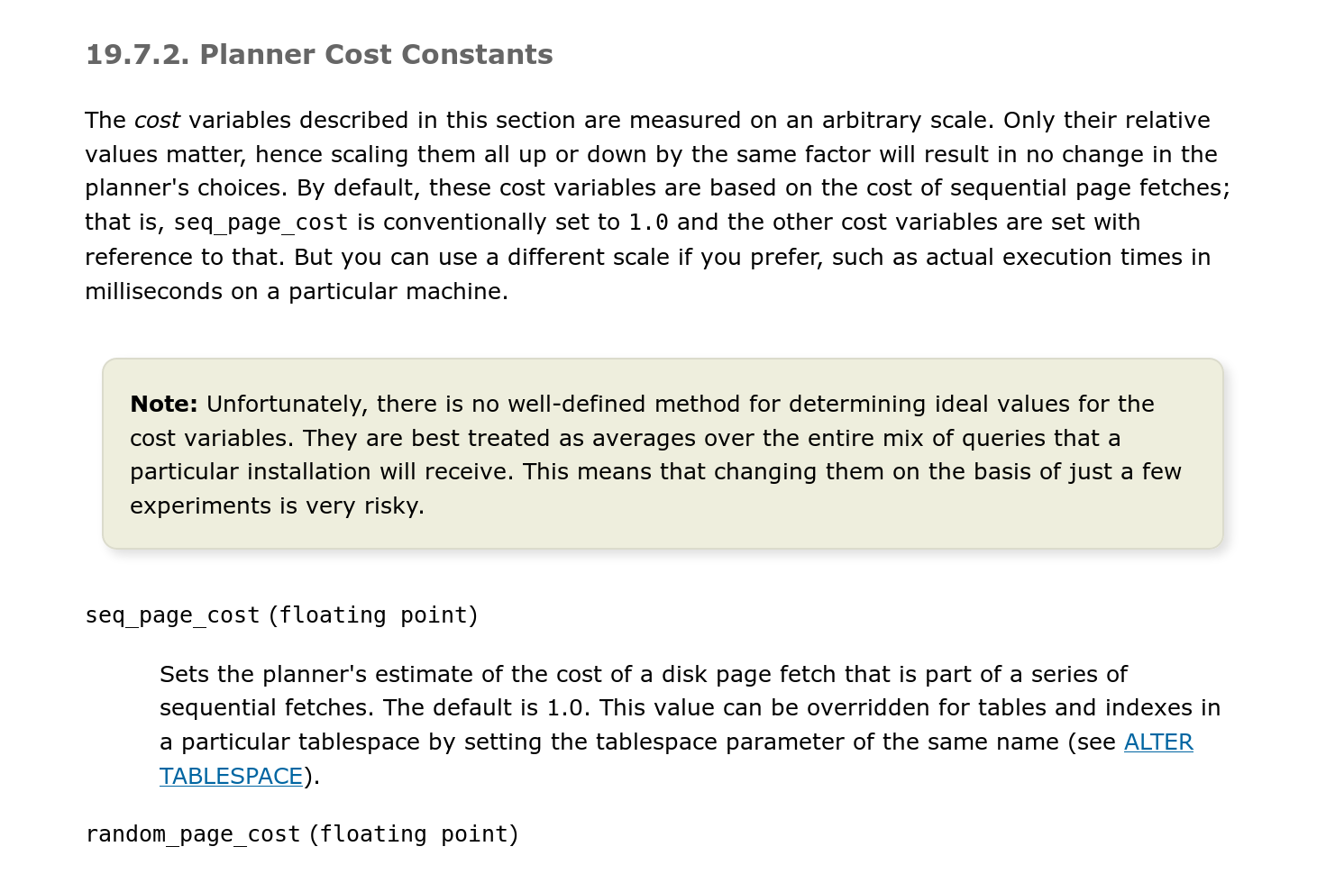
Postgres Cost Model
Uses a combination of CPU and I/O costs that are weighted by “magic” constant factors.
Default settings are obviously for a disk-resident database without a lot of memory:
Processing a tuple in memory is 400x faster than reading a tuple from disk.
Sequential I/O is 4x faster than random I/O.
Notes:
These numbers are generally stable. But overtime they can drift.

Slide 40
Statistics
The DBMS stores internal statistics about tables, attributes, and indexes in its internal catalog.
Different systems update them at different times.
Manual invocations:
Postgres/SQLite: ANALYZE
Oracle/MySQL: ANALYZE TABLE
SQL Server: UPDATE STATISTICS
DB2: RUNSTATS
Notes:
It is too expensive to run every possible plan to determine this information, so the DBMS need a way to derive this information…
Manual or periodic invocation from the system

Slide 41
Selection Cardinality
The selectivity (sel) of a predicate P is the fraction of tuples that qualify.
Equality Predicate: A=constant
sel(A=constant) = #occurences/|R|
Example: sel(age=9) =
SELECT * FROM people WHERE age = 9
4/45
# of occurrences
SC(age=9)=4
Distinct values of attribute
Notes:
Assume that the age attribute has five distinct values (0–4).
Instead of an exact age, we'll put people in groups. Advertisers do this: under18, 18-35, 35-50

Slide 42
Selection Cardinality
Assumption #1: Uniform Data
The distribution of values (except for the heavy hitters) is the same.
Assumption #2: Independent Predicates
The predicates on attributes are independent
Assumption #3: Inclusion Principle
The domain of join keys overlap such that each key in the inner relation will also exist in the outer table.
Notes:
These are the common assumptions that many systems will make when computing selection cardinality.
It will cause errors, but it makes the math easier.
Heavy Hitters: Skewed dataset, keep a separate data structure that gives an exact count for the top 10 most common keys and then approximate the rest.
Independent: If conjunctions, multiple probabilities together to get combined cardinality.
Inclusion: Every tuple in inner table must match a tuple in the outer table.

Slide 43
Correlated Attributes
Consider a database of automobiles:
# of Makes = 10, # of Models = 100
And the following query:
(make=“Honda” AND model=“Accord”)
With the independence and uniformity assumptions, the selectivity is:
1/10 × 1/100 = 0.001
But since only Honda makes Accords the real selectivity is 1/100 = 0.01
Source: Guy Lohman
Notes:
Some systems allow specifying correlated attributes

Slide 44
Statistics
Choice #1: Histograms
Maintain an occurrence count per value (or range of values) in a column.
Choice #2: Sketches
Probabilistic data structure that gives an approximate count for a given value.
Choice #3: Sampling
DBMS maintains a small subset of each table that it then uses to evaluate expressions to compute selectivity.

Slide 45
Histograms
Our formulas are nice, but we assume that data values are uniformly distributed.
# of occurrences
Distinct values of attribute
15 Keys × 32-bits = 60 bytes
Notes:
Problem is that we are maintaining an exact count for every key in a column.
15 unique keys * 32-bits = 60 bytes
1 billion values * 32-bits = 4GB

Slide 46
Equi-width Histogram
Maintain counts for a group of values instead of each unique key. All buckets have the same width (i.e., same # of value).
Bucket Ranges
Bucket #1
Count=8
Bucket #2
Count=4
Bucket #3
Count=15
Bucket #4
Count=3
Bucket #5
Count=14
Notes:
For every three values, compute the sum of the frequencies and that's the value for that bucket.
Then to estimate the frequency, take the count and divide it by the size of bucket.

Slide 47
Equi-depth Histograms
Vary the width of buckets so that the total number of occurrences for each bucket is roughly the same.
Bucket #1
Count=12
Bucket #2
Count=12
Bucket #3
Count=9
Bucket #4
Count=12

Slide 48
Sketches
Probabilistic data structures that generate approximate statistics about a data set.
Cost-model can replace histograms with sketches to improve its selectivity estimate accuracy.
Most common examples:
Count-Min Sketch (1988): Approximate frequency count of elements in a set.
HyperLogLog (2007): Approximate the number of distinct elements in a set.

Slide 49
Sampling
Modern DBMSs also collect samples from tables to estimate selectivities.
Update samples when the underlying tables changes significantly.
SELECT AVG(age) FROM people WHERE age > 50
id | name | age | status
1001 | Obama | 63 | Rested
1002 | Swift | 34 | Paid
1003 | Tupac | 25 | Dead
1004 | Bieber | 30 | Crunk
1005 | Andy | 43 | Illin
1006 | TigerKing | 61 | Jailed
Table Sample
1001 | Obama | 63 | Rested
1003 | Tupac | 25 | Dead
1005 | Andy | 43 | Illin
sel(age>50) =
1/3
⋮
1 billion tuples

Slide 50
Conclusion
Query optimization is critical for a database system.
SQL → Logical Plan → Physical Plan
Flatten queries before going to the optimization part. Expression handling is also important.
Estimate costs using models based on summarizations.
QO enumeration can be bottom-up or top-down.
If you like this and want to make cash money after you leave CMU, take 15-799 in spring 2025.

Slide 51
Next Class
Transactions!
A first lesson in transactions: Ben agrees to sell Zhongrui his car for $10k, so we need to transfer the money and update the title registry:
UPDATE acct SET balance = balance – 10k WHERE customer = 'Zhongrui';
UPDATE acct SET balance = balance + 10k WHERE customer = 'Ben';

Slide 52
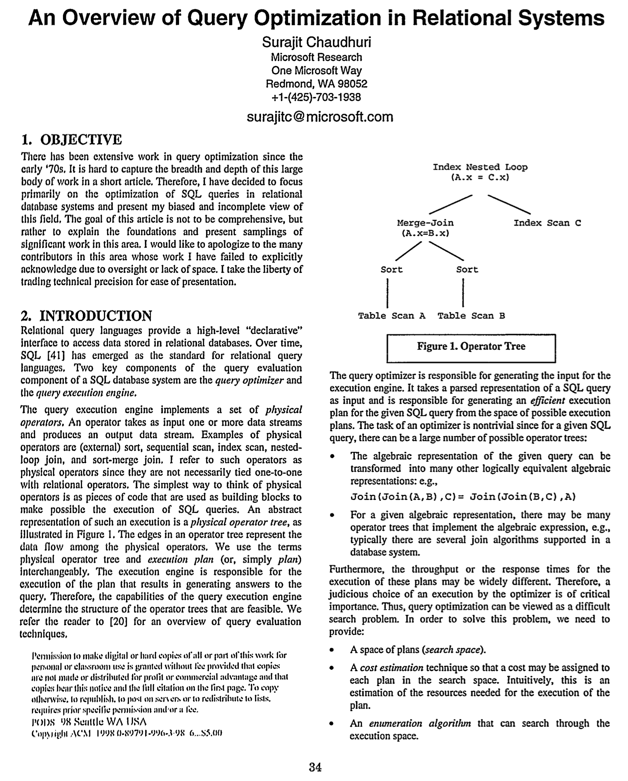
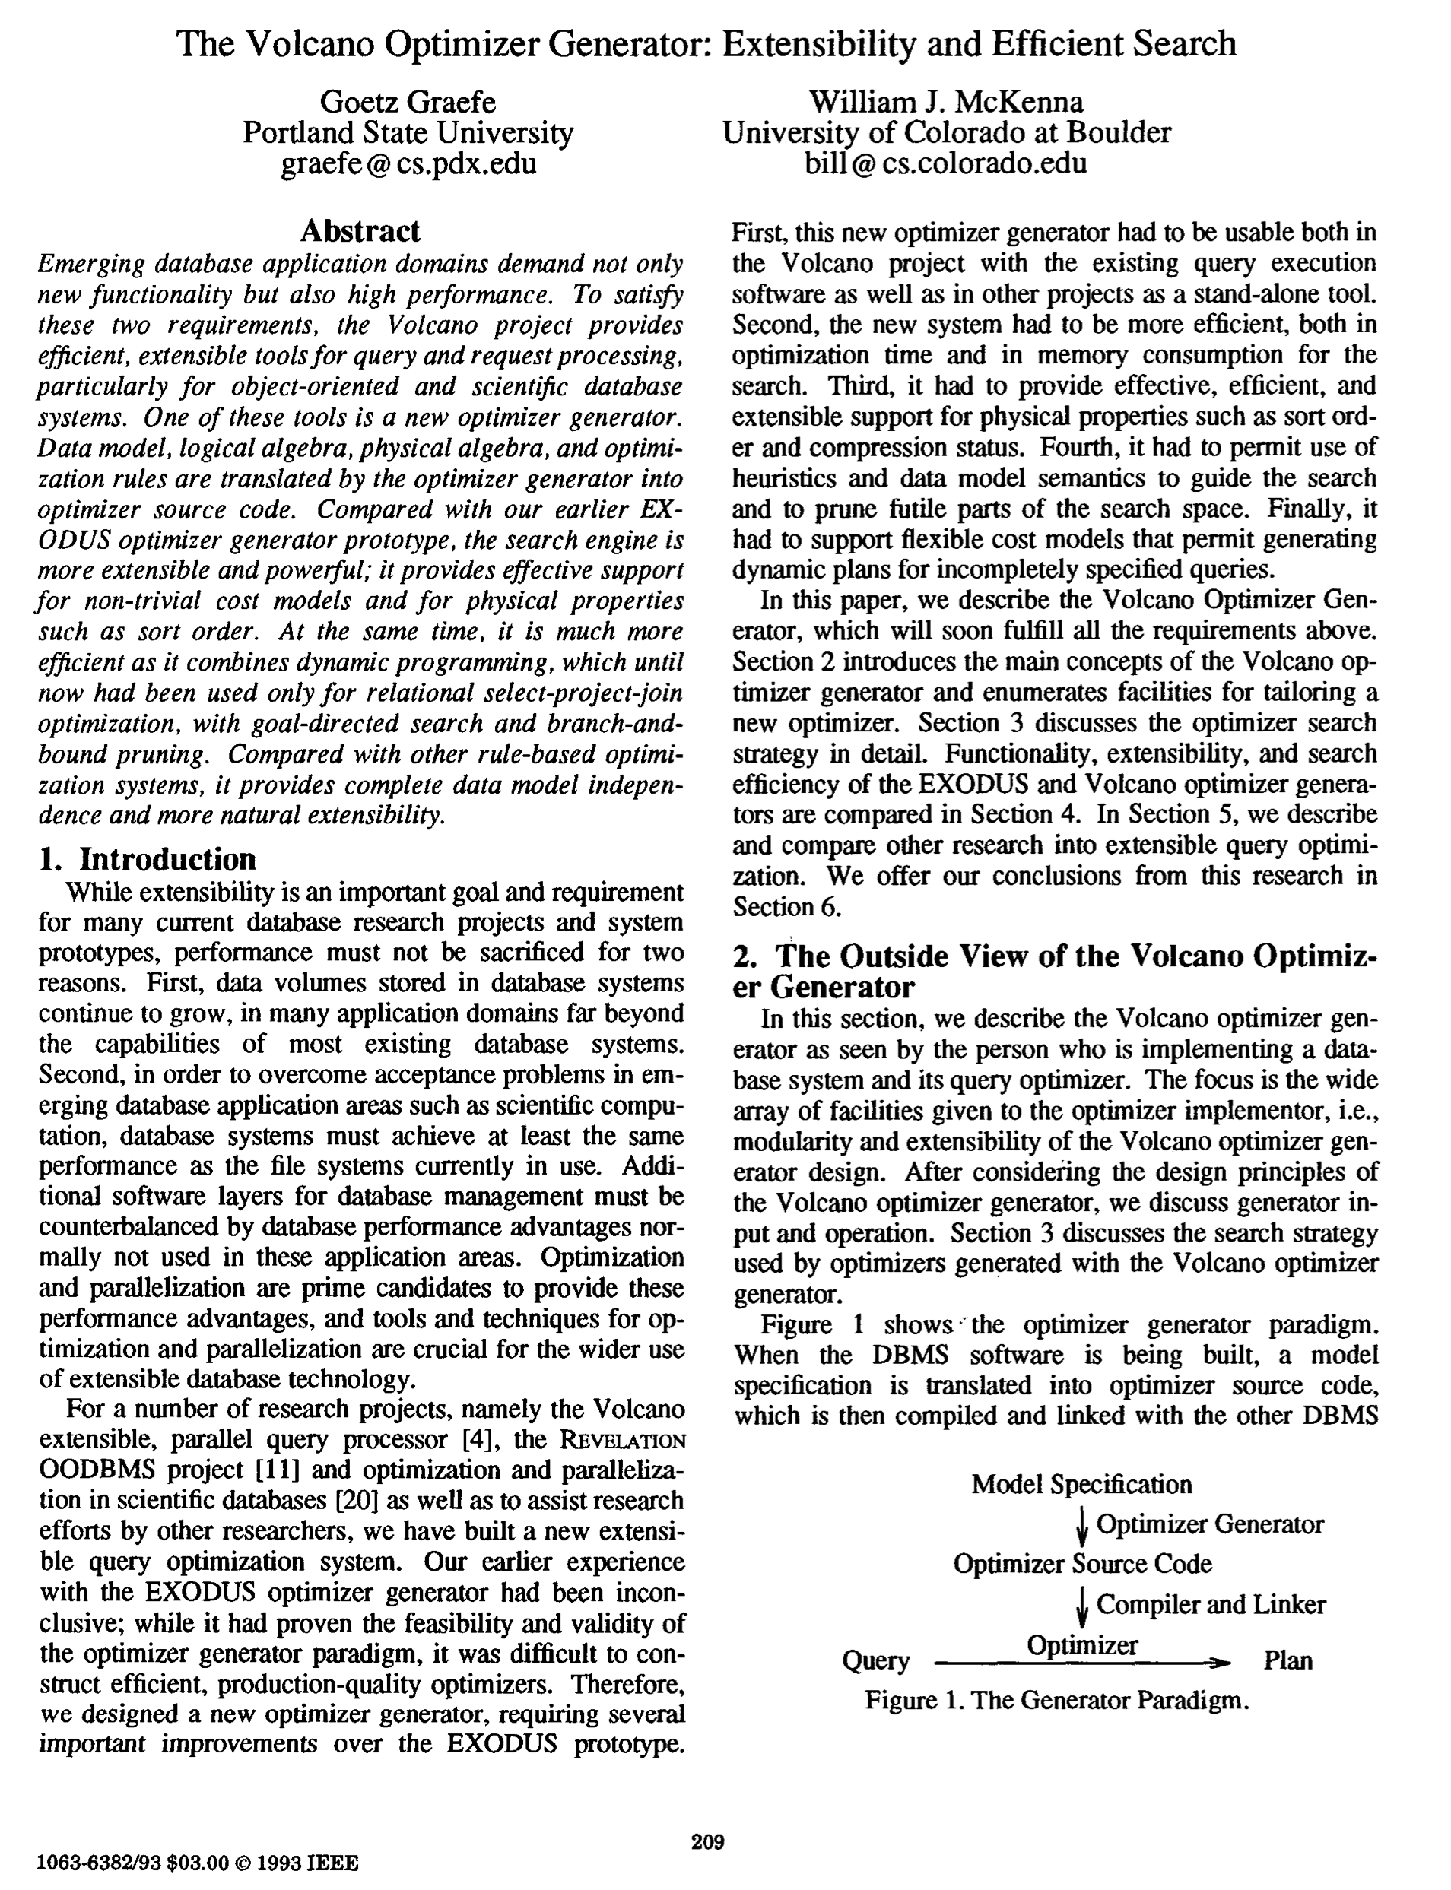
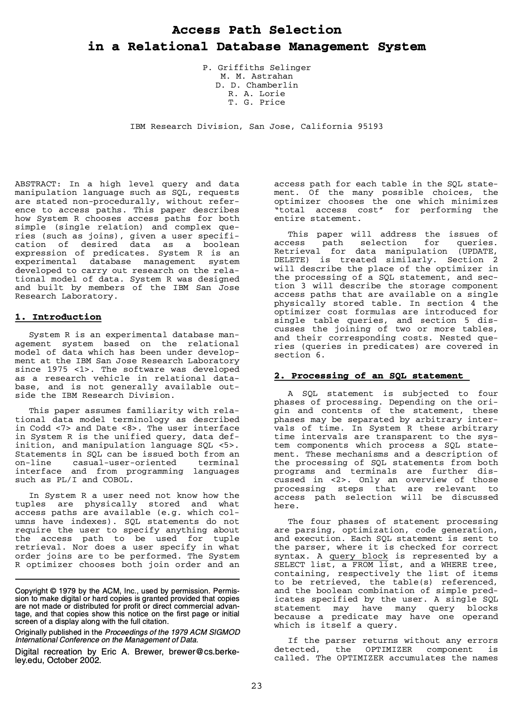
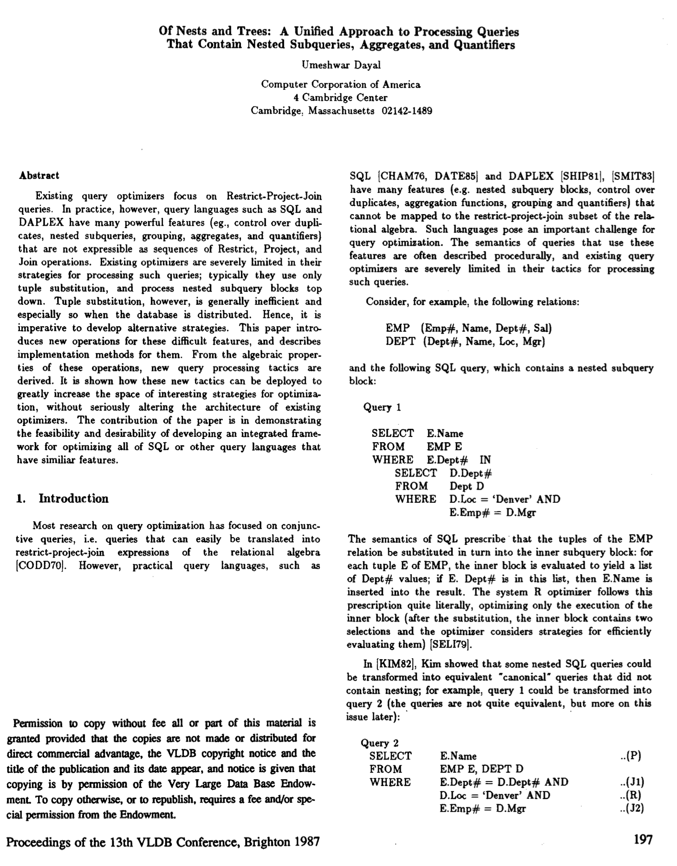
Essential Query Optimization papers
Bonus
Surajit Chaudhuri: An Overview of Query Optimization in Relational Systems. PODS 1998: 34-43
Goetz Graefe, William J. McKenna: The Volcano Optimizer Generator: Extensibility and Efficient Search. ICDE 1993: 209-218
Patricia G. Selinger, Morton M. Astrahan, Donald D. Chamberlin, Raymond A. Lorie, Thomas G. Price: Access Path Selection in a Relational Database Management System. SIGMOD Conference 1979: 23-34
Umeshwar Dayal: Of Nests and Trees: A Unified Approach to Processing Queries That Contain Nested Subqueries, Aggregates, and Quantifiers. VLDB 1987: 197-208

Slide 53
Suggestions if you are going to build a QO
Bonus
Rule 1: Read lots of papers, especially from the 80s & 90s.
Expect new combinations, only partially new core inventions.
Rule 2: Early on, test various workloads on the QO.
QOs harden over time as they “see” new workloads. Let them see more ASAP.
Rule 3: Throw away the initial one (or two) and start anew.
The hard part is going to be nitty-gritty details like data structures and pointers to shared objects; e.g., the list of predicates and the query graph structure, … You will NOT get this right in the first pass. Don’t try to patch; be prepared to rewrite.

Slide 54
RELATIONAL ALGEBRA EQUIVALENCES
Two relational algebra expressions are equivalent if they generate the same set of tuples.
The DBMS can identify better query plans without a cost model.
This is often called query rewriting.
Notes:
We can rely on our understanding of relational algebra to permute/transform a rel alg expression into a new expression that is "better" and still produce the same results.

Slide 55
PREDICATE PUSHDOWN
SELECT s.name, e.cid
FROM student AS s JOIN enrolled AS e
ON s.sid = e.sid
WHERE e.grade = 'A'
π
π
π_{name, cid}(σ_{grade='A'}(student⋈enrolled))
s.name,e.cid
s.name,e.cid
σ
grade='A'
⨝
s.sid=e.sid
⨝
s.sid=e.sid
σ
grade='A'
student
enrolled
student
enrolled

Slide 56
RELATIONAL ALGEBRA EQUIVALENCES
SELECT s.name, e.cid
FROM student AS s JOIN enrolled AS e
ON s.sid = e.sid
WHERE e.grade = 'A'
π_{name, cid}(σ_{grade='A'}(student⋈enrolled))
=
π_{name, cid}(student⋈(σ_{grade='A'}(enrolled)))

Slide 57
RELATIONAL ALGEBRA EQUIVALENCES
Selections:
Perform filters as early as possible.
Break a complex predicate, and push down σ_{p1∧p2∧…pn}(R) = σ_{p1}(σ_{p2}(…σ_{pn}(R)))
Simplify a complex predicate
(X=Y AND Y=3) → X=3 AND Y=3

Slide 58
RELATIONAL ALGEBRA EQUIVALENCES
Joins:
Commutative, associative R⋈S = S⋈R (R⋈S)⋈T = R⋈(S⋈T)
The number of different join orderings for an n-way join is a Catalan Number (≈4^{n})
Exhaustive enumeration will be too slow.
Notes:
We’ll see next week how an optimizer limits the search space...

Slide 59
RELATIONAL ALGEBRA EQUIVALENCES
Projections:
Perform them early to create smaller tuples and reduce intermediate results (if duplicates are eliminated)
Project out all attributes except the ones requested or required (e.g., joining keys)
This is not important for a column store…

Slide 60
PROJECTION PUSHDOWN
SELECT s.name, e.cid
FROM student AS s JOIN enrolled AS e
ON s.sid = e.sid
WHERE e.grade = 'A'
π
π
s.name,e.cid
s.name,e.cid
⨝
s.sid=e.sid
⨝
s.sid=e.sid
π
sid,cid
σ
grade='A'
sid,name
π
σ
grade='A'
student
enrolled
student
enrolled
Notes:
More often in distributed systems

Slide 61
STATISTICS
For each relation R, the DBMS maintains the following information:
N_{R}: Number of tuples in R.
V(A,R): Number of distinct values for attribute A.
Notes:
This is most basic info we need to maintain per table.
Use case:
N_R: sequential scan
V(A, R): distinct, hash join

Slide 62
DERIVABLE STATISTICS
The selection cardinality SC(A,R) is the average number of records with a value for an attribute A given N_{R} / V(A,R)
Note that this formula assumes data uniformity where every value has the same frequency as all other values.
Example: 10,000 students, 10 colleges – how many students in SCS?

Slide 63
LOGICAL COSTS
Equality predicates on unique keys are easy to estimate.
Computing the logical cost of complex predicates is more difficult…
CREATE TABLE people (
id INT PRIMARY KEY,
val INT NOT NULL,
age INT NOT NULL,
status VARCHAR(16)
);
SELECT * FROM people WHERE id = 123
SELECT * FROM people WHERE age = 30 AND status = 'Lit'
AND age+id IN (1,2,3)
SELECT * FROM people WHERE val > 1000
Notes:
The goal is to use the selection cardinality to estimate how many tuples an operator is going to have to process. We can then use that information to determine how much disk/memory/cpu or whatever else we want to track the operator will consume.
Id=123 (cardinality=1)

Slide 64
SELECTIONS – COMPLEX PREDICATES
Range Predicate:
sel(A>=a) = (A_{max}– a+1) / (A_{max}– A_{min}+1)
Example: sel(age>=2)
SELECT * FROM people WHERE age >= 2
≈ (4–2+1) / (4–0+1)
≈ 3/5
age_{min} = 0
age_{max} = 4

Slide 65
SELECTIONS – COMPLEX PREDICATES
Negation Query:
sel(not P) = 1 – sel(P)
Example: sel(age != 2)
Observation: Selectivity ≈ Probability
SELECT * FROM people WHERE age != 2
= 1 – (1/5) = 4/5
SC(age!=2)=2
SC(age!=2)=2
SC(age=2)=1
Notes:
The major observation we can make is that the selectivity is roughly the probability that something will match.
If we assume this, then we can use all the tricks Stats 101 to combine these together to handle more complex prediates

Slide 66
SELECTIONS – COMPLEX PREDICATES
Conjunction:
sel(P1 ⋀ P2) = sel(P1) ∙ sel(P2)
sel(age=2 ⋀ name LIKE 'A%')
This assumes that the predicates are independent.
SELECT * FROM people WHERE age = 2
AND name LIKE 'A%'
Not always true in practice!
P₁
P₂

Slide 67
SELECTIONS – COMPLEX PREDICATES
Disjunction:
sel(P1 ⋁ P2) = sel(P1) + sel(P2) – sel(P1⋀P2) = sel(P1) + sel(P2) – sel(P1) ∙ sel(P2)
sel(age=2 OR name LIKE 'A%')
This again assumes that the selectivities are independent.
SELECT * FROM people WHERE age = 2
OR name LIKE 'A%'
P₁
P₂

Slide 68
RESULT SIZE ESTIMATION FOR JOINS
Given a join of R and S, what is the range of possible result sizes in # of tuples?
In other words, for a given tuple of R, how many tuples of S will it match?
Assume each key in the inner relation will exist in the outer table.
This is super hard.

Slide 69
RESULT SIZE ESTIMATION FOR JOINS
General case: R_{cols}⋂S_{cols}={A} where A is not a primary key for either table.
Match each R-tuple with S-tuples: estSize ≈ N_{R} ∙ N_{S} / V(A,S)
Symmetrically, for S: estSize ≈ N_{R} ∙ N_{S} / V(A,R)
Overall:
estSize ≈ N_{R} ∙ N_{S} / max({V(A,S), V(A,R)})

Slide 70
LOGICAL PLAN OPTIMIZATION
Transform a logical plan into an equivalent logical plan using pattern matching rules.
The goal is to increase the likelihood of enumerating the optimal plan in the search.
Cannot compare plans because there is no cost model but can "direct" a transformation to a preferred side.
Notes:
The enumeration step will come next week.
Cannot guarantee that we will always find the optimal plan.

Slide 71
LOGICAL QUERY OPTIMIZATION
Split Conjunctive Predicates
Predicate Pushdown
Replace Cartesian Products with Joins
Projection Pushdown
Source: Thomas Neumann

Slide 72
SPLIT CONJUNCTIVE PREDICATES
SELECT ARTIST.NAME
FROM ARTIST, APPEARS, ALBUM
WHERE ARTIST.ID=APPEARS.ARTIST_ID
AND APPEARS.ALBUM_ID=ALBUM.ID
AND ALBUM.NAME="Andy's OG Remix"
π
ARTIST.NAME
σ
ARTIST.ID=APPEARS.ARTIST_ID
σ
ARTIST.ID=APPEARS.ARTIST_ID AND
APPEARS.ALBUM_ID=ALBUM.ID AND ALBUM.NAME="Andy's OG Remix"
σ
APPEARS.ALBUM_ID=ALBUM.ID
Decompose predicates into their simplest forms to make it easier for the optimizer to move them around.
σ
ALBUM.NAME="Andy's OG Remix"
×
×
ARTIST
APPEARS
ALBUM
Notes:
In this example, all predicates are in the WHERE clause. So they would get put into a single filter operator.
We then apply the filter after the cartesian product. We know this is inefficient.
Break up the single predicate into multiple predicates for each conjunction so that we change their location in the tree.
For ORs, you have to make duplicate expressions.

Slide 73
SELECTION CARDINALITY
Formula depends on type of predicate:
Equality
Range
Negation
Conjunction
Disjunction
sel(P) = SC(P) / NR
# of tuples
Selection Cardinality
Notes:
Selectivity is a function that says for a given predicate on a table, what is the fraction of tuples that will satisfy that predicate.
Last slide should an equality example. Now we need to account for other type of expressions.

Slide 74
EXPRESSION REWRITING
Join Elimination with Sub-Query
CREATE TABLE A (
id INT PRIMARY KEY,
val INT NOT NULL );
SELECT * FROM A AS A1
WHERE EXISTS(SELECT val FROM A AS A2
WHERE A1.id = A2.id);
SELECT * FROM A;
Source: Lukas Eder
Notes:
Sakila: https://github.com/jOOQ/jOOQ/tree/master/jOOQ-examples/Sakila
-- IMPOSSIBLE QUERY PLAN
-- Postgres
EXPLAIN ANALYZE SELECT * FROM actor WHERE 1 = 0;
-- MySQL
EXPLAIN SELECT * FROM actor WHERE 1 = 0 \G
-- MSSQL
SET SHOWPLAN_TEXT ON;
SELECT * FROM actor WHERE 1 = 0;
-- Oracle
EXPLAIN PLAN FOR SELECT * FROM actor WHERE 1 = 0;
SELECT PLAN_TABLE_OUTPUT FROM TABLE(DBMS_XPLAN.DISPLAY());
-- Sqlite?
EXPLAIN QUERY PLAN SELECT * FROM actor WHERE 1 = 0;
-- USELESS PREDICATE
EXPLAIN ANALYZE SELECT * FROM actor WHERE 1 = 1;
EXPLAIN SELECT * FROM actor WHERE 1 = 1 \G
SET SHOWPLAN_TEXT ON;
SELECT * FROM actor WHERE 1 = 1;
EXPLAIN QUERY PLAN SELECT * FROM actor WHERE 1 = 1;
-- RANGE QUERY
EXPLAIN ANALYZE SELECT * FROM film WHERE film_id BETWEEN 1 AND 2 AND film_id BETWEEN 199 AND 200;
EXPLAIN SELECT * FROM film WHERE film_id BETWEEN 1 AND 2 AND film_id BETWEEN 199 AND 200 \G
EXPLAIN QUERY PLAN SELECT * FROM film WHERE film_id BETWEEN 1 AND 2 AND film_id BETWEEN 199 AND 200;
-- PROJECTION PRUNING
SELECT EXISTS(SELECT 1 / 0);
SELECT EXISTS( SELECT pow(-1, 0.5) );

Slide 75
IBM DB2 COST MODEL
Database characteristics in system catalogs
Hardware environment (microbenchmarks)
Storage device characteristics (microbenchmarks)
Communications bandwidth (distributed only)
Memory resources (buffer pools, sort heaps)
Concurrency Environment
Average number of users
Isolation level / blocking
Number of available locks
Source: Guy Lohman
Notes:
Database characteristics (in system catalogs)
–Schema, including constraints
–Statistics on tables, columns, indexes, etc.
Hardware environment
– Speed of CPU
determined automatically at database creation time
runs a timing program
– Storage device characteristics
used to model random and sequential I/O costs
set at table-space level
overhead (seek & average rotational latency)
transfer_rate
– Communications bandwidth
to factor communication cost into overall cost, in partitioned environments
– Memory resources
Buffer pool(s)
Sort heap
Concurrency Environment
– Average number of users
– Isolation level / blocking
– Number of available locks

